Slide 1
Association Mining
By: Dr. Farhana Desai

Slide 2
What is Association Mining?
Association Rule Mining is used when you want to find an association between different objects in a set, find frequent patterns in a transaction database, relational databases or any other information repository.
The applications of Association Rule Mining are found in Marketing, Basket Data Analysis (or Market Basket Analysis) in retailing, clustering and classification.
It can tell you what items do customers frequently buy together by generating a set of rules called Association Rules.

Slide 3
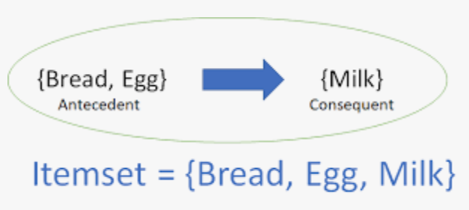
In simple words, it gives you output as rules in form if this then that. Clients can use those rules for numerous marketing strategies. An association rule consists of an antecedent (if part) and a consequent (then part). The dataset contains an antecedent, and we derive a consequent by using the antecedent.

Slide 4
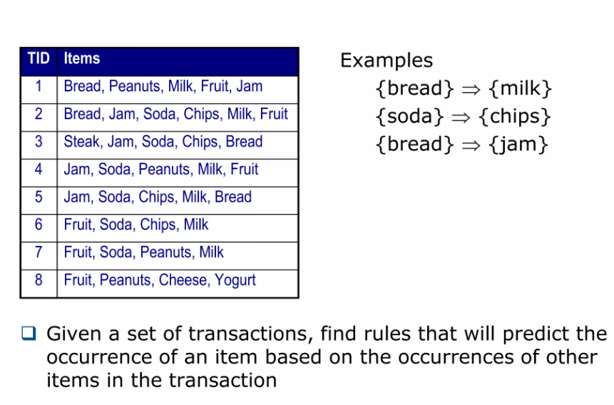
Association Rule Mining

Slide 5
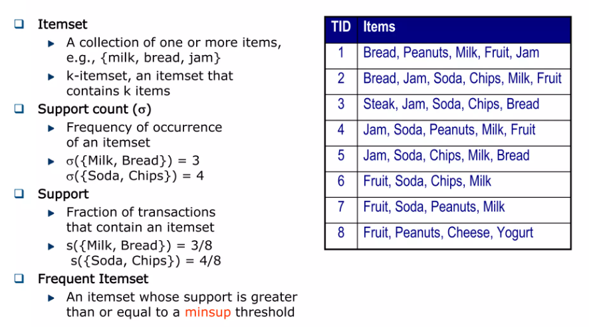
Association Rule Mining

Slide 6
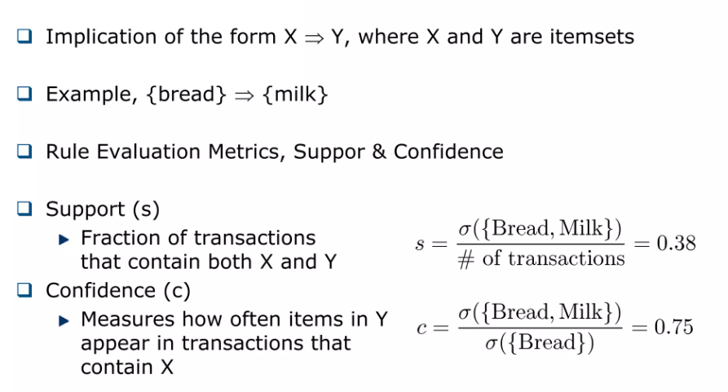
Association Rule Mining

Slide 7
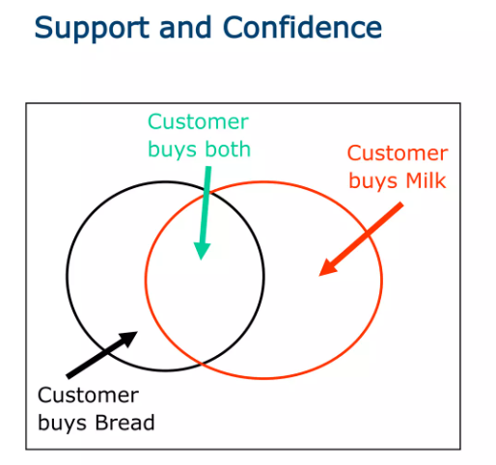
Association Rule Mining

Slide 8
Implementation

Slide 9
install.packages(“package name”)
data() shows all the datasets in the library
? algorithm/dataset
Package
Load
Help
History
Data
List of last 25 commands executed in RStudio
library(packagename)

Slide 10
Parameters in Association Mining :
minval is the minimum value of the support an itemset should satisfy to be a part of a rule.
smax is the maximum support value for an itemset.
arem is an Additional Rule Evaluation Parameter. In the above code we have constrained the number of rules using Support and Confidence. There are several other ways to constrain the rules using the arem parameter in the function and we will discuss more about it later in the article.
aval is a logical indicating whether to return the additional rule evaluation measure selected with arem.
originalSupport The traditional support value only considers both LHS and RHS items for calculating support. If you want to use only the LHS items for the calculation then you need to set this to FALSE.
maxtime is the maximum amount of time allowed to check for subsets.
minlen is the minimum number of items required in the rule.
maxlen is the maximum number of items that can be present in the rule.

Slide 11
Results
max growth
RStudio Output

Slide 12
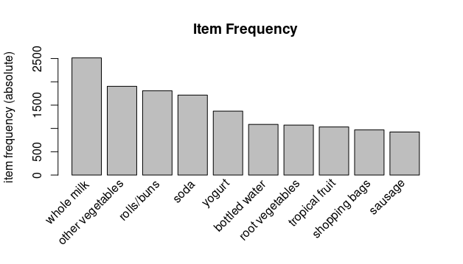

Slide 13
